Slide 1
Beamline Upgrade
for
in behalf of BEA,
OPE, TRI, VAC,
ENG Department
and many others
involved in this
improvment
Beata Walasek-Höhne

Slide 2
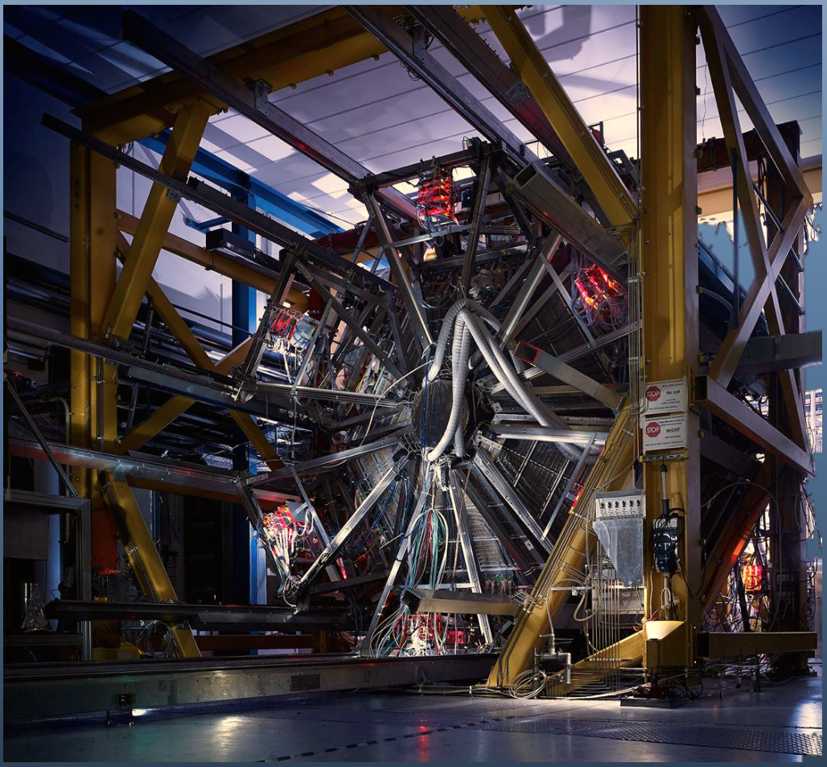
High Acceptance Di-Electron Spectrometer
The HADES experiment poses two questions:
„What does the quark-antiquark cloud look like?”
“Why is it there?”
HADES comprises of six identical detector systems arranged as the segments of a circle.
This setup enables the detection of the majority of the particles produced during a collision in the target.
https://www-hades.gsi.de/

Slide 3
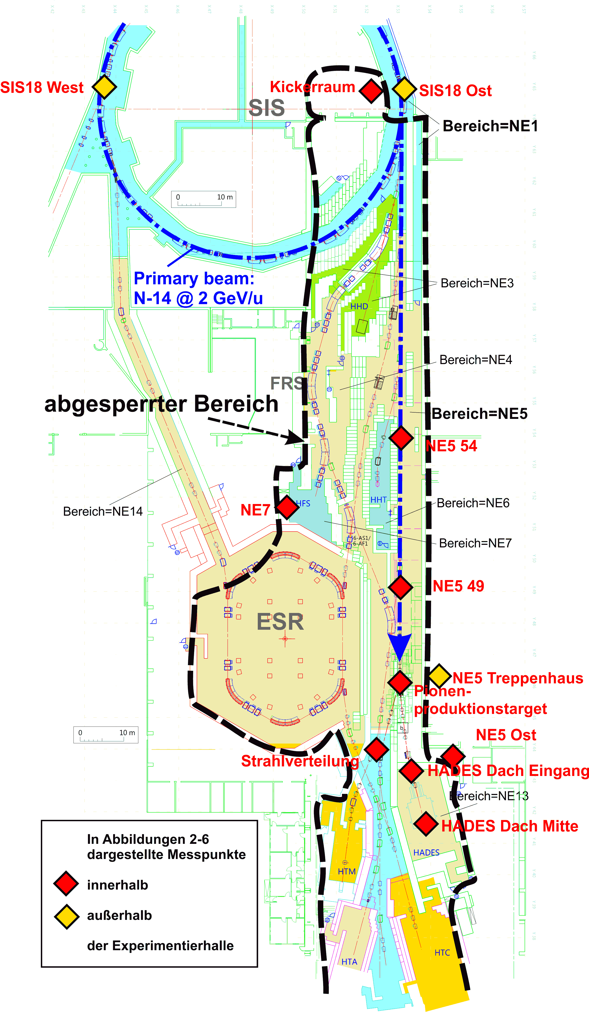
Motivation
Higher statistics is required
improve transmission
improve spill structure
NE5_Aktivitätsmessungen_07.06.11_08.07.14

Slide 4
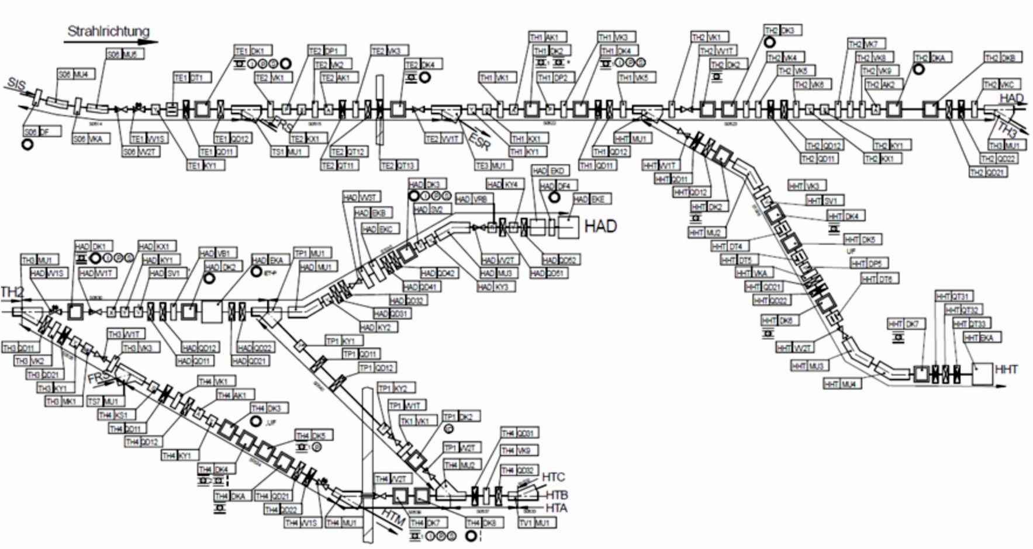
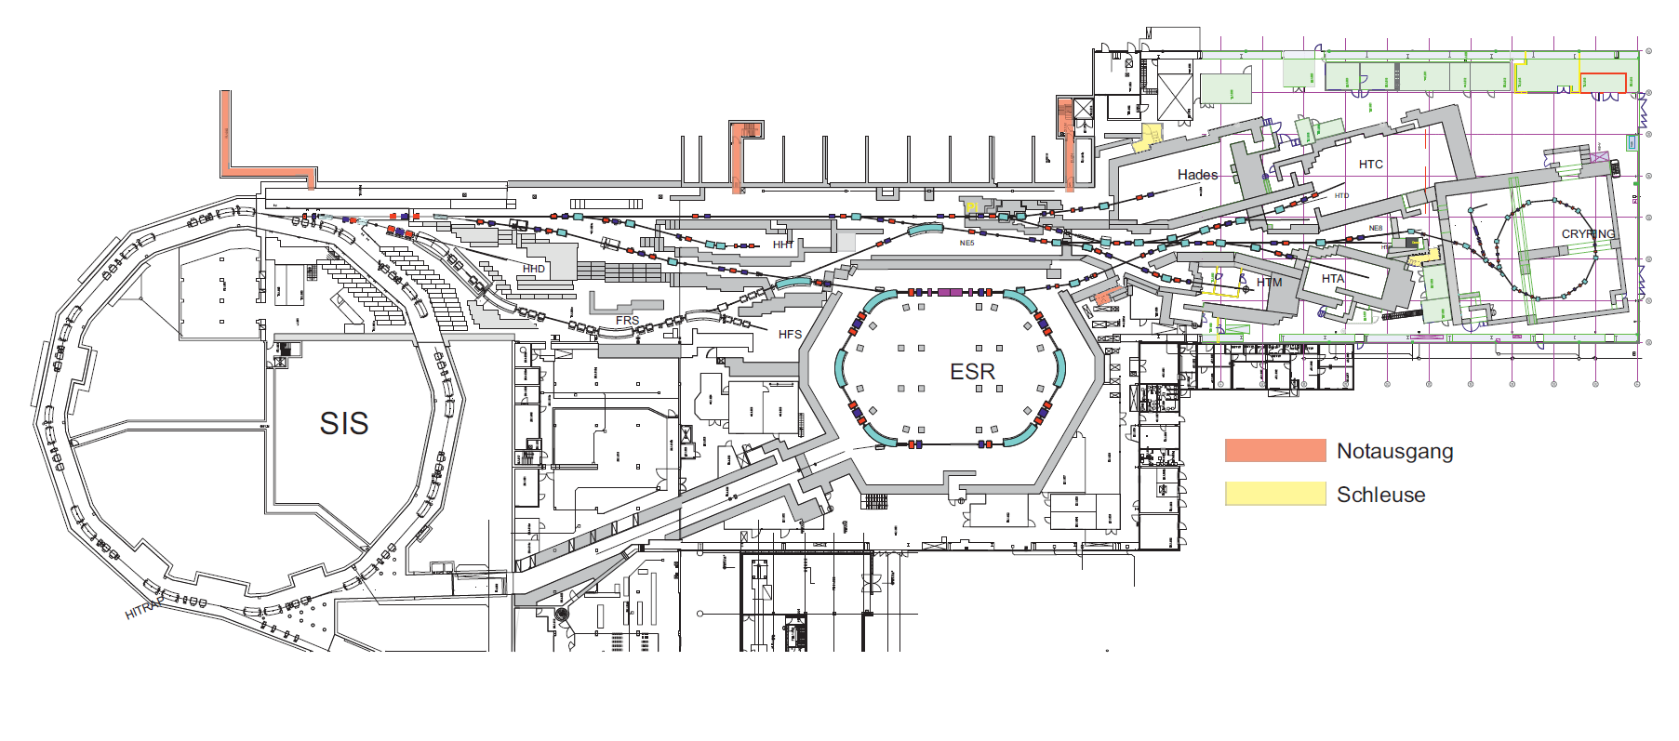
Beamline
The beamline lies completely within NE-5 area
GHADMU2
two of the dipole magnets (GHADMU1 and GHADMU2)
are rotated around beam axis
Notes:
4

Slide 5
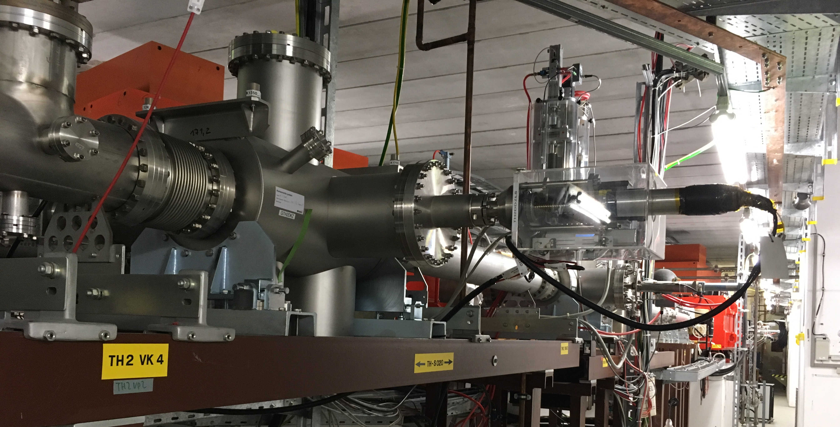
Beamline
The beamline lies completely within NE-5 area
NE-5 area
TH2 diagnostic chambers

Slide 6
Beamline

Slide 7
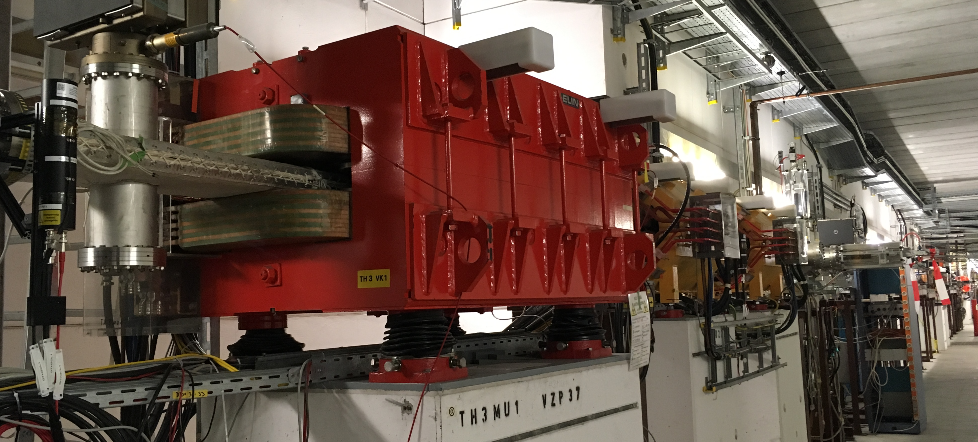
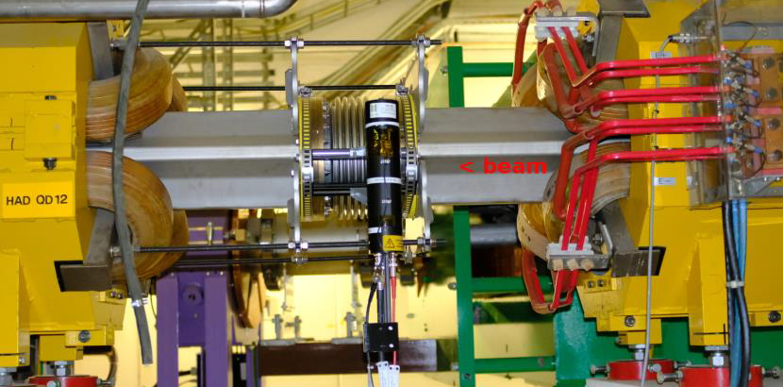
Beamline
GTH3MU1
GHADQD12

Slide 8
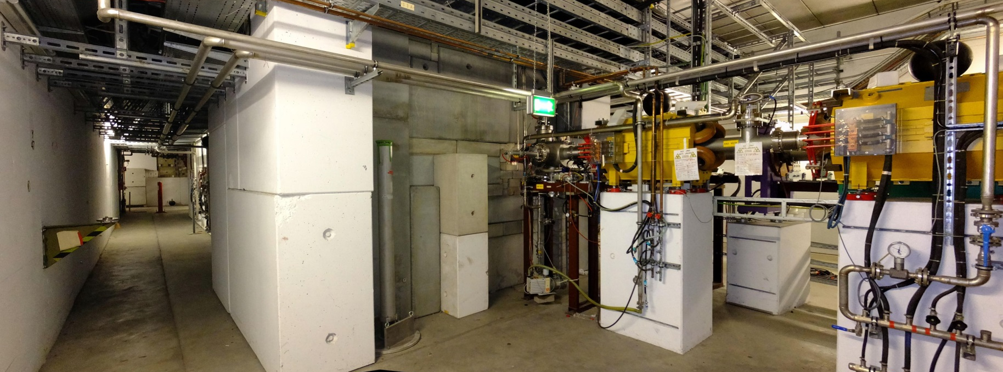
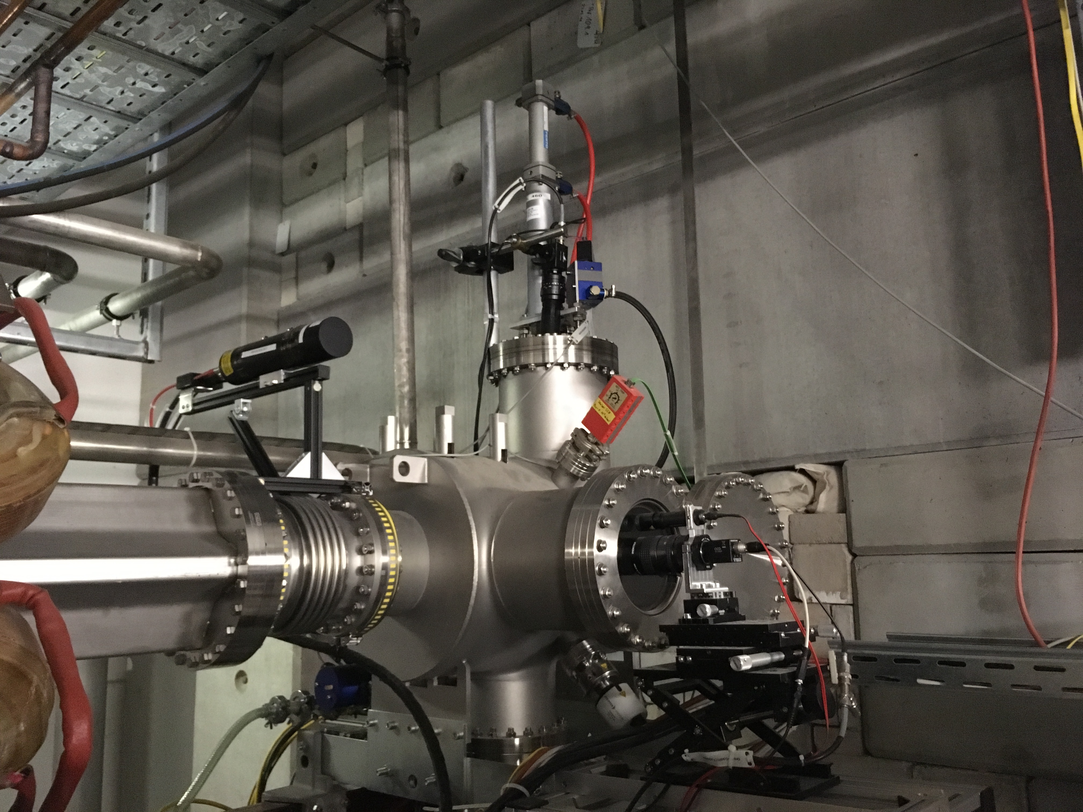
Beamline
Beamline in front of pion target
GHADDK2

Slide 9
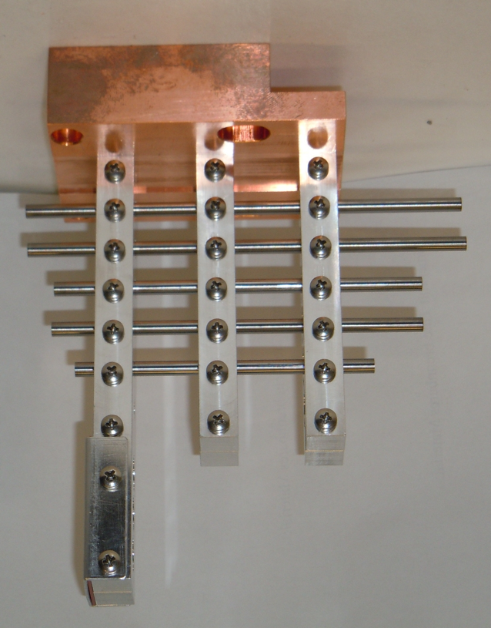
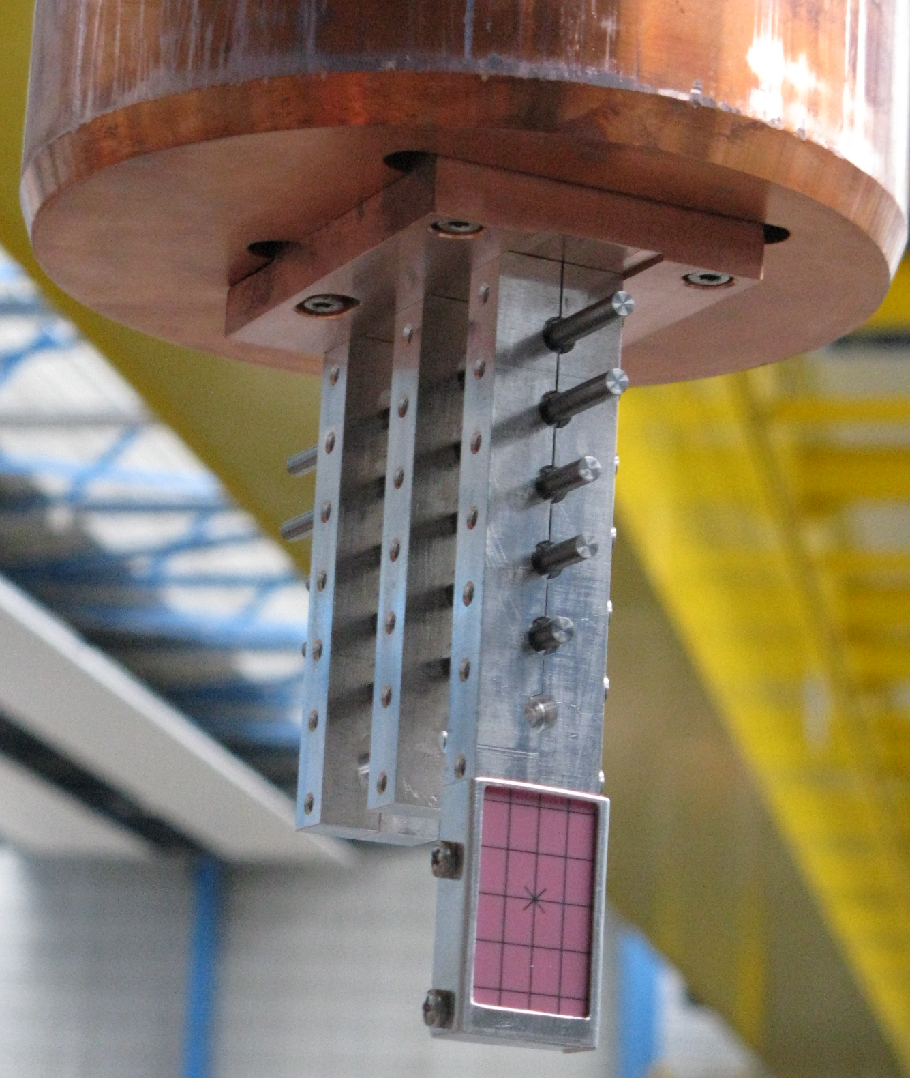
Pion Target
The pion production target is shielded in a bunker and is remotely controlled

Slide 10
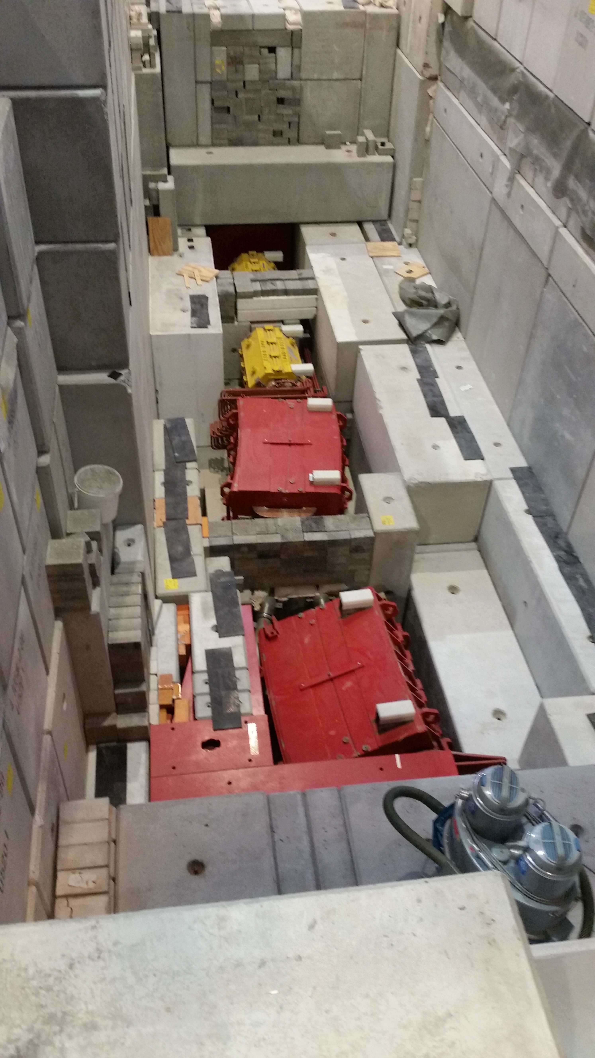
Beamline
GHADMU1
Beamline behind pion target

Slide 11
Beamline
HADES experiment uses two kinds of beams:
low intensity heavy ion beam which interacts with a target inside the experimental area (called HADES target)
pion beam produced by an interaction of high-intensity ion beam with thick Beryllium target, upstream of the Hades target

Slide 12
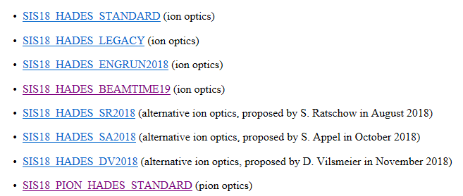
HADES Beam Optics
Beam Optics
There are two main types of ion optics, depending whether the pion production target is used (pion optics) or not (ion optics)
http://sapinski.web.cern.ch/sapinski/physics/HEST/HEST(2f)HAD(2f)experiment.html

Slide 13
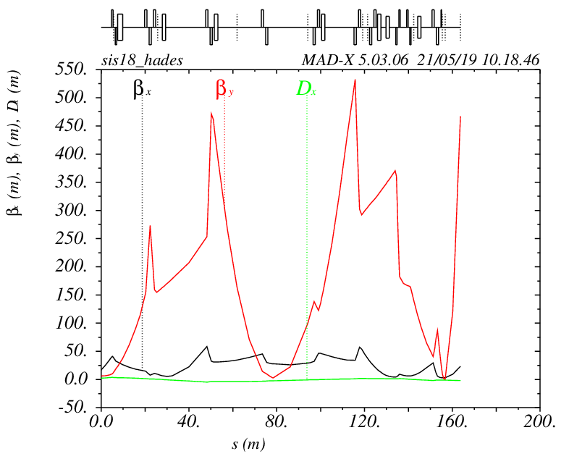
Ion Optics: Mariusz`s focus
Ion beam optics used for Beamtime 2019 was different than the one developed during the Engineering Run 2018 (different slow extraction settings)
stronger focusing of GTE1QD11 and smaller defocusing of GTE1QD12
These quadrupoles do not only provide focusing but are used for steering, especially at high rigidities
Result:
optics with significant better horizontal focusing but much larger vertical beta
function

Slide 14
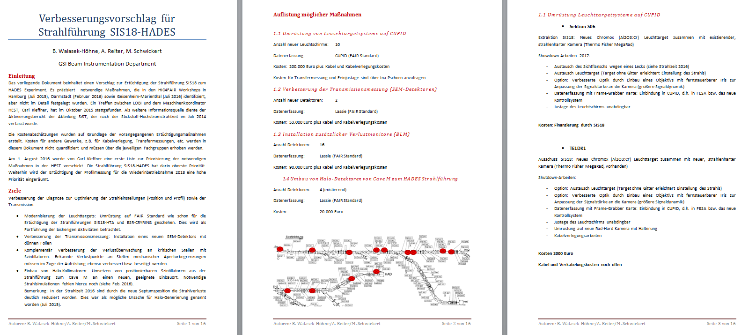
Proposal for improvement

Slide 15
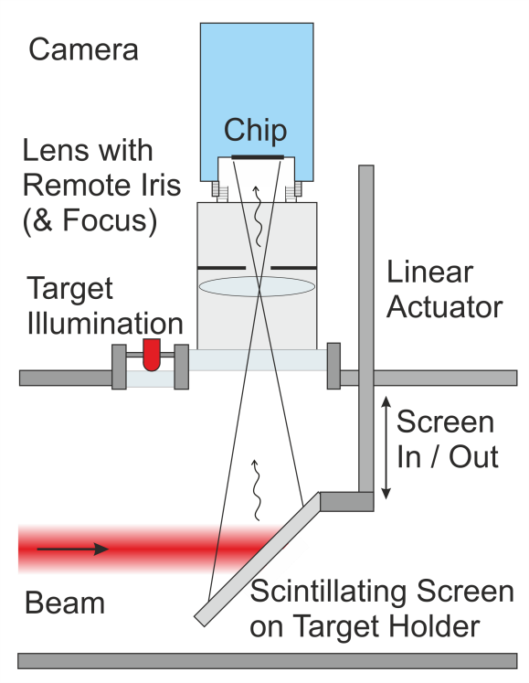
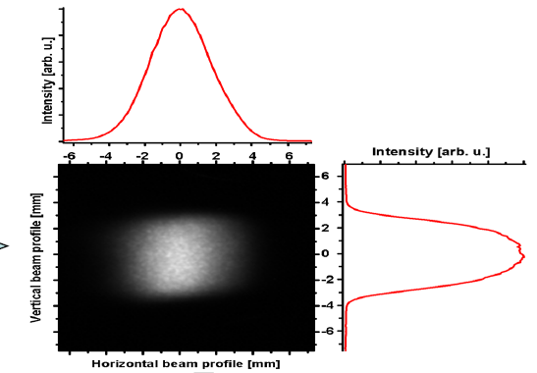
CUPID
Scintillating screens are widely used in accelerator facilities for transversal beam profile
simple, reliable profile measurement system
used for beam alignment
most direct way of beam observation: complete 2D information

Slide 16
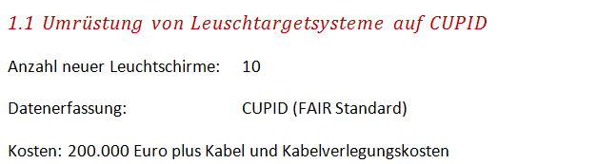
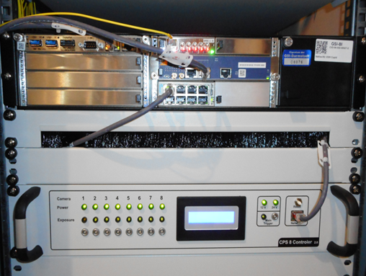
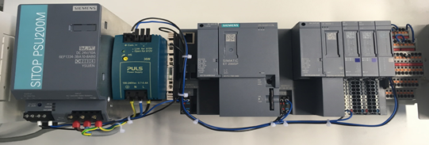
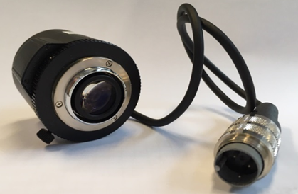
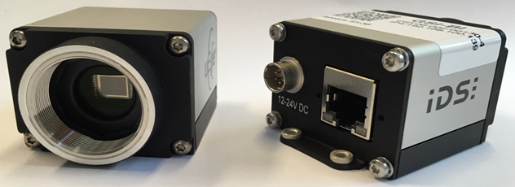
CUPID

Slide 17
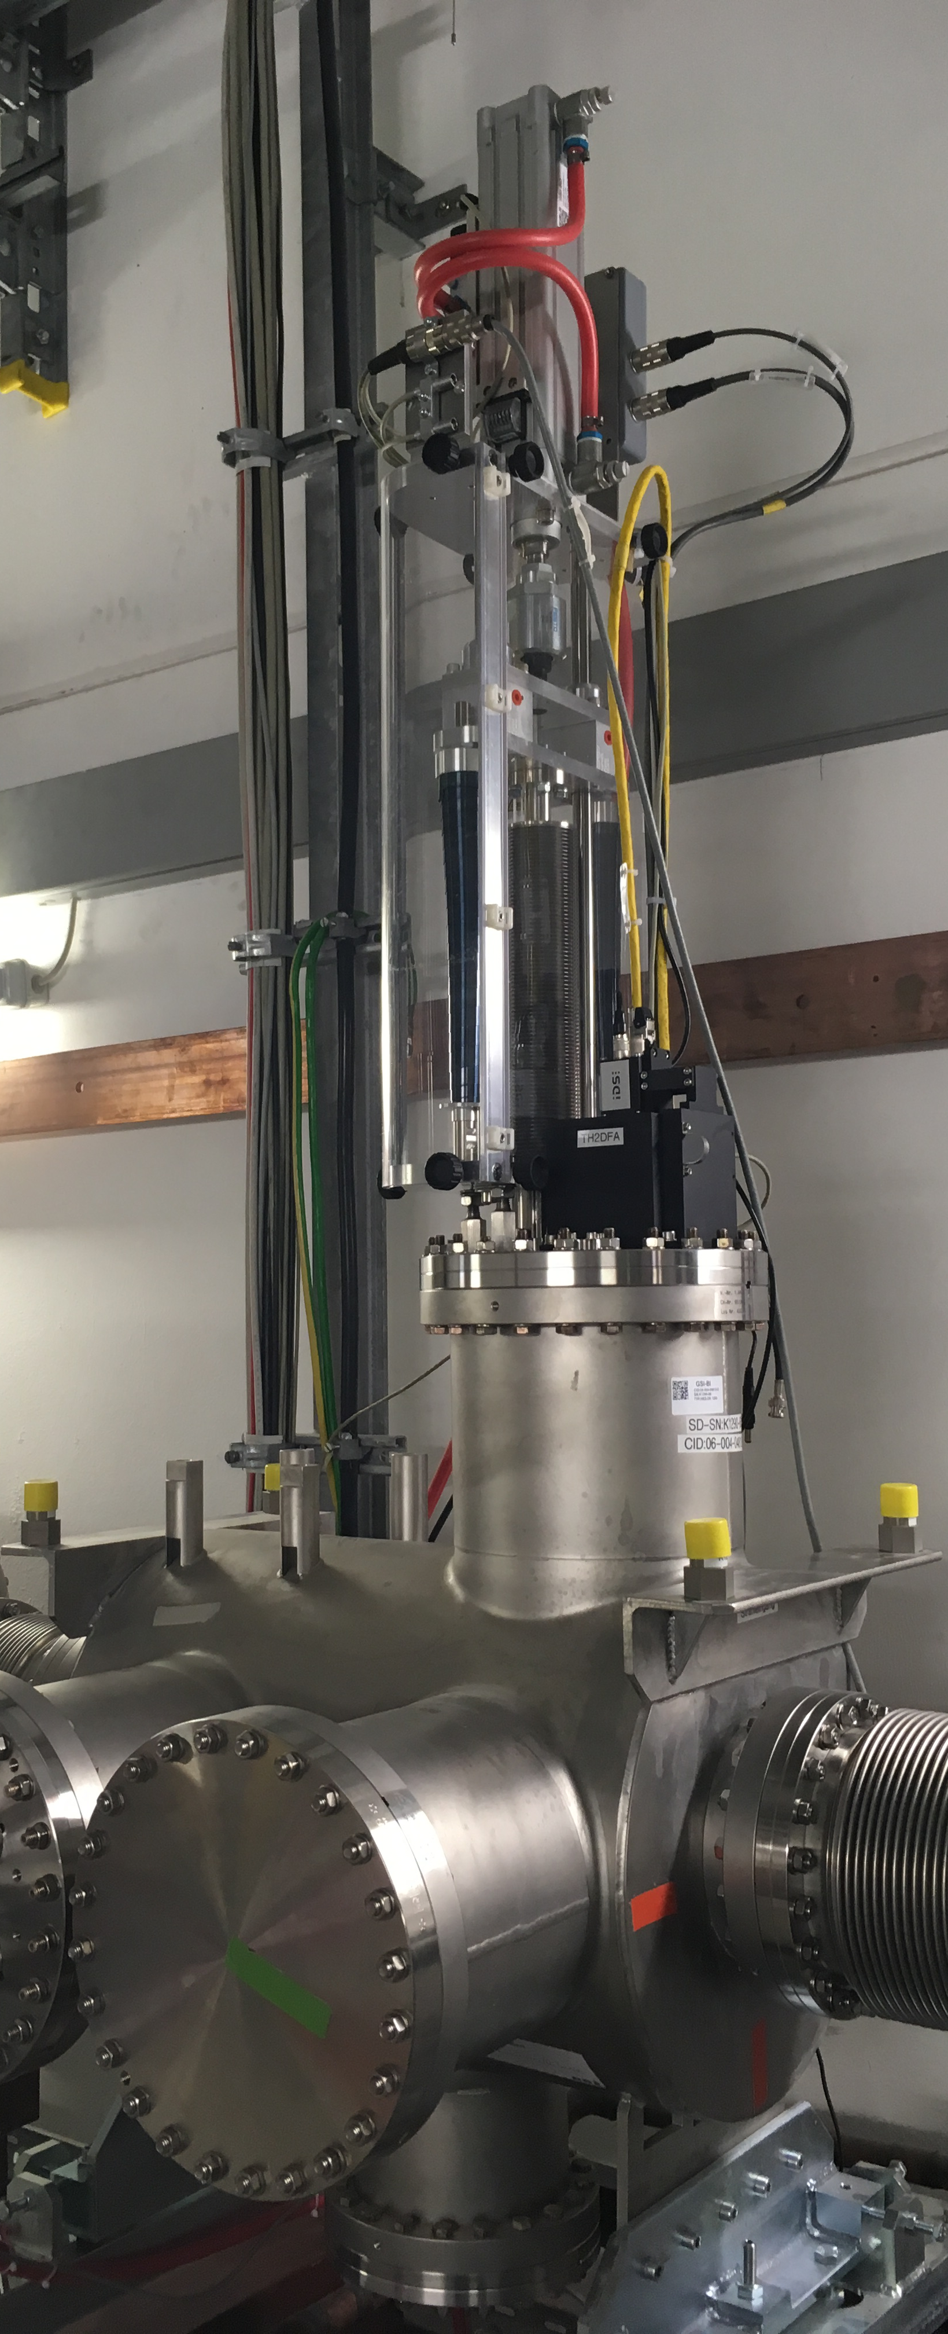
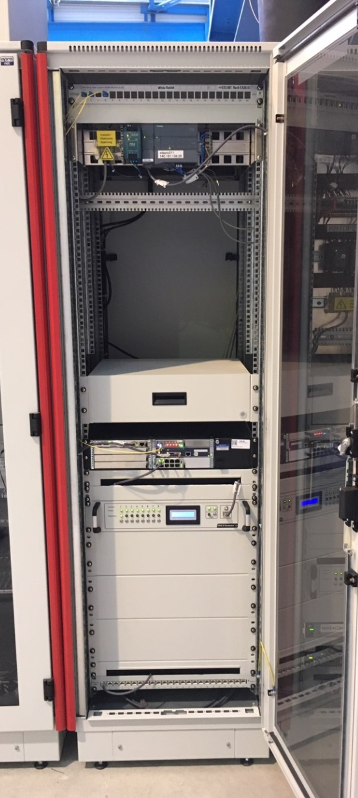
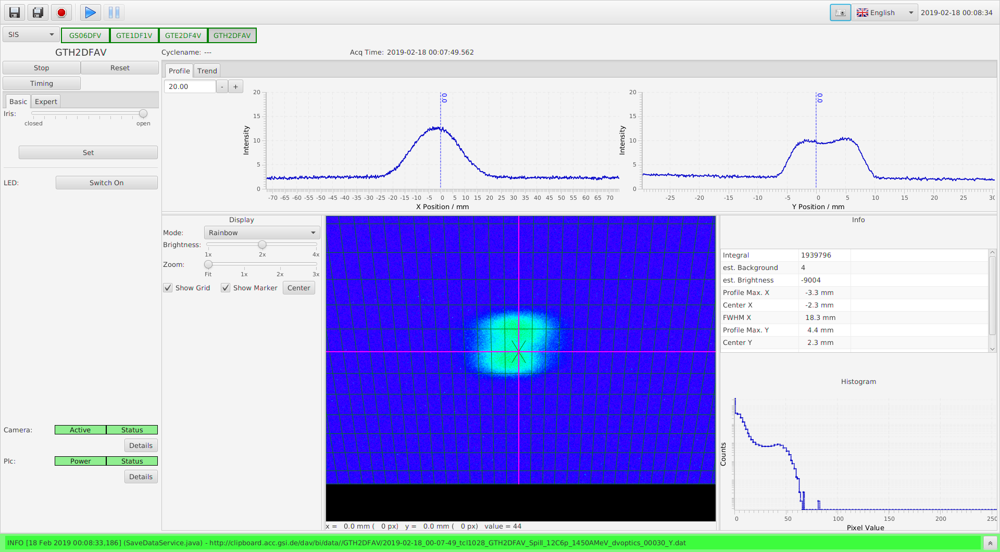
CUPID
GUI
Rack
TH2DFA

Slide 18
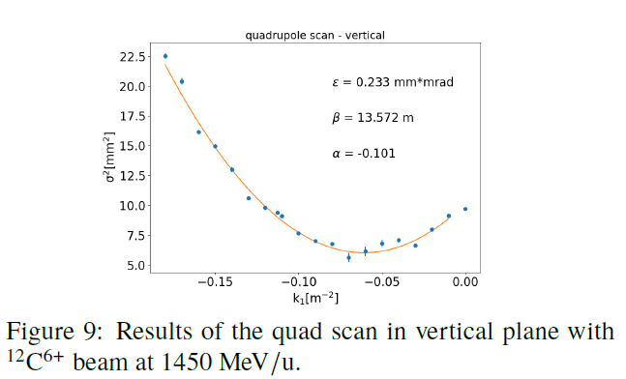
CUPID
TH2DFA
QUADRUPOLE SCAN
Quadrupole scan allows to determine beam emittance and twiss parameters at the entrance of the quadrupole magnet (GTH2QD12). The scan is done by measuring the beam size on a downstream screen (GTH2DFA) while changing the strength of the magnet. Quadrupole strength variation rotates the phase space ellipse, the projections of beam ellipse are registered and its twiss parameters are calculated.
M. Sapinski et al. „Measurements and corrections of the GSI Transfer beam lines ion optics https://ipac2019.vrws.de/papers/mopgw024.pdf

Slide 19
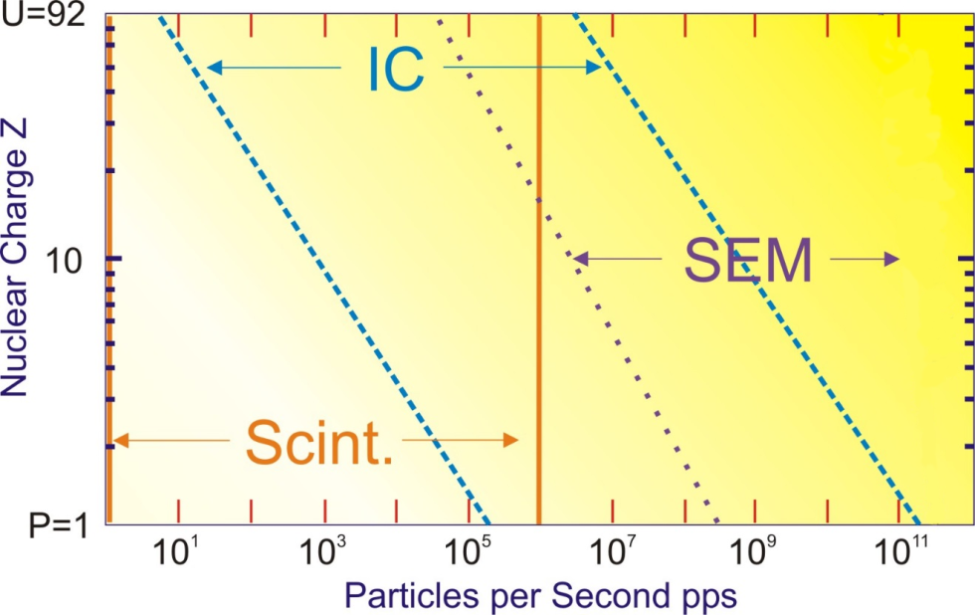
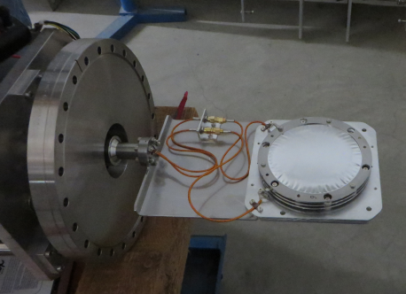
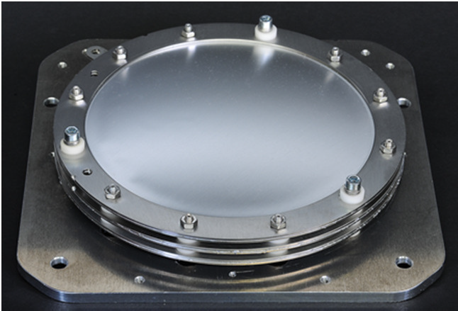
SEM Foils
The task of the SEM-Foil detector is to measure the beam intensity of slowly extracted beams
determine, optimize and monitor the beam transmission
temporal beam structure
dedicated source of beam loss
new SEM design tested at HTP

Slide 20
SEM Foils

Slide 21
SEM Foils
TH2DKA
TH2DK2

Slide 22
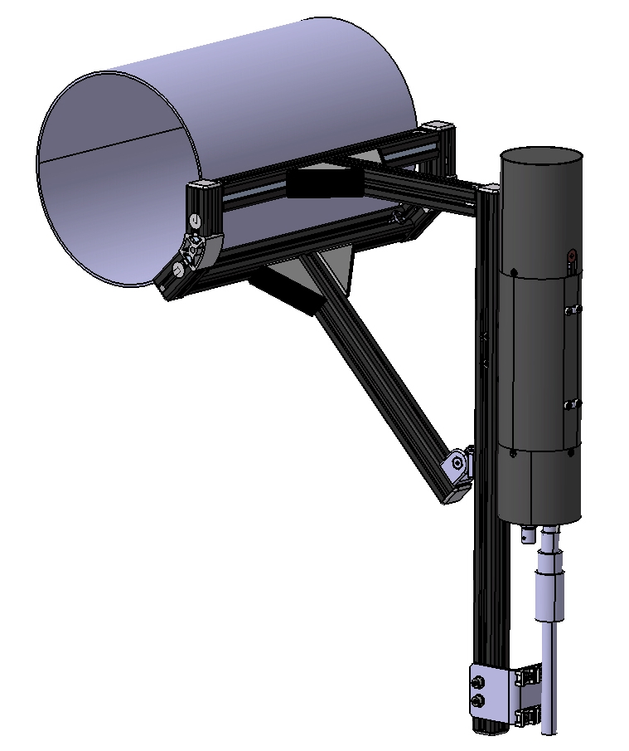
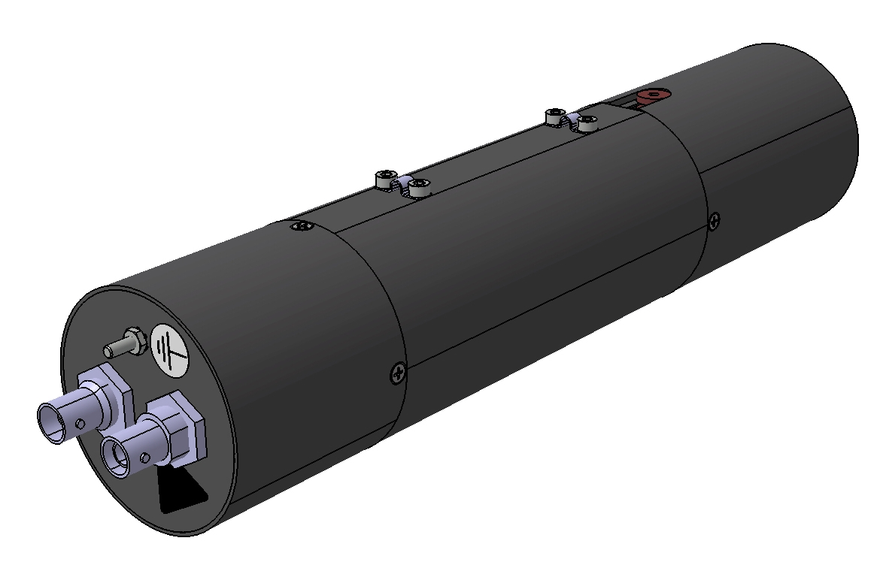
BLM
Beam loss monitoring system (BLM) is used to monitor the beam losses.
If beam interacts with the inner side of a beam tube, the lost particles hit the walls and create secondary particle showers, which can be observed and measured outside of the beam tube
plastic scintillators are very fast and suitable for all types of losses
the usage is recommended for loss rates up to few 10⁷ counts per second
each detector has the same response function

Slide 23
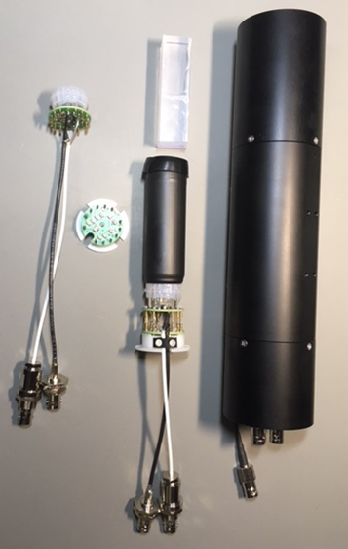
BLM
based on plastic scintillator
16 (18) locations along the HADES beamline
stand alone solution for LASSIE Data Acquisition System (HHT Dach)
fully FAIR compatible System

Slide 24
BLM Locations
1 | GS06DL5I | in font of magnetic Septum |  | 10 | GTH2DL3 | behind TH2QD12
2 | GS06DL5A | behind magnetic Septum |  | 11 | GTH2DL4 | behind TH2QD21
3 | GTE1DL1 | behind TE1QD12 |  | 12 | GTH2DL5 | in front of TH3MU1
4 | GTS1DL1 | behind TS1MU1 |  | 13 | GTH3DL1 | behind TH3MU1
5 | GTE2DL1 | behind TE2QT13 |  | 14 | GHADDL1 | in front of HADQD11
6 | GTE3DL1 | behind TE3MU1 |  | 15 | GHADDL2 | behind HADQD11
7 | GTH1DL1 | behind TH1QD12 |  | 16 | GHADDL3 | behind HADQD12
8 | GHHTDL1 | behind HHTMU1 |  | 17 | GHADDL4 | in front of HADQD41
9 | GTH2DL1 | behind TH2QD11 |  | 18 | GHADDL5 | behind HADQD42

Slide 25
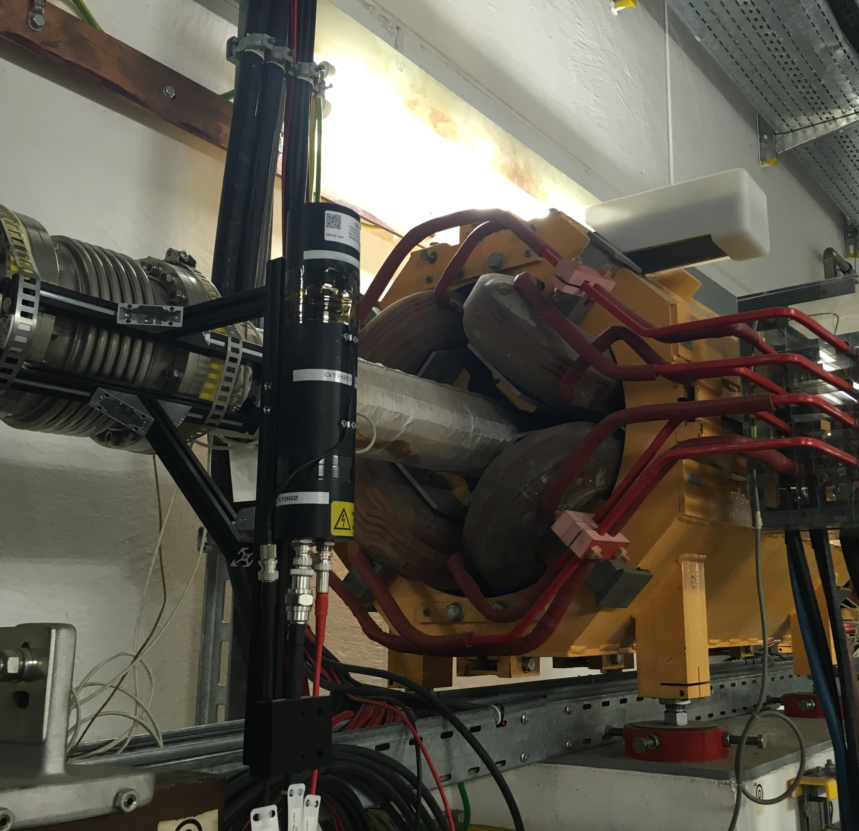
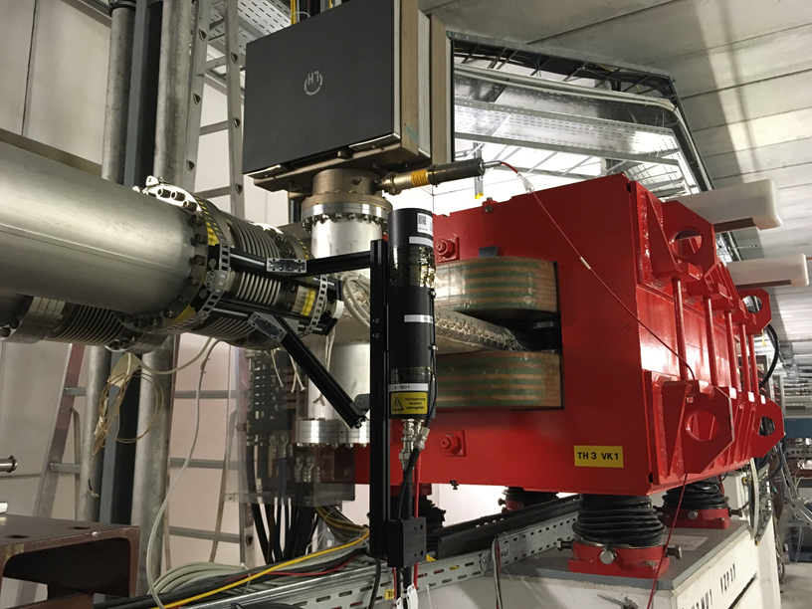
BLM Locations
TH2DL3
TH3DL3

Slide 26
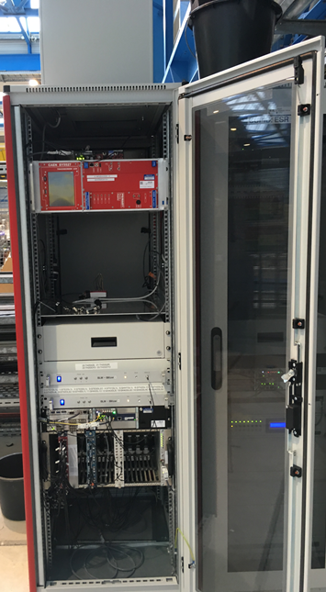
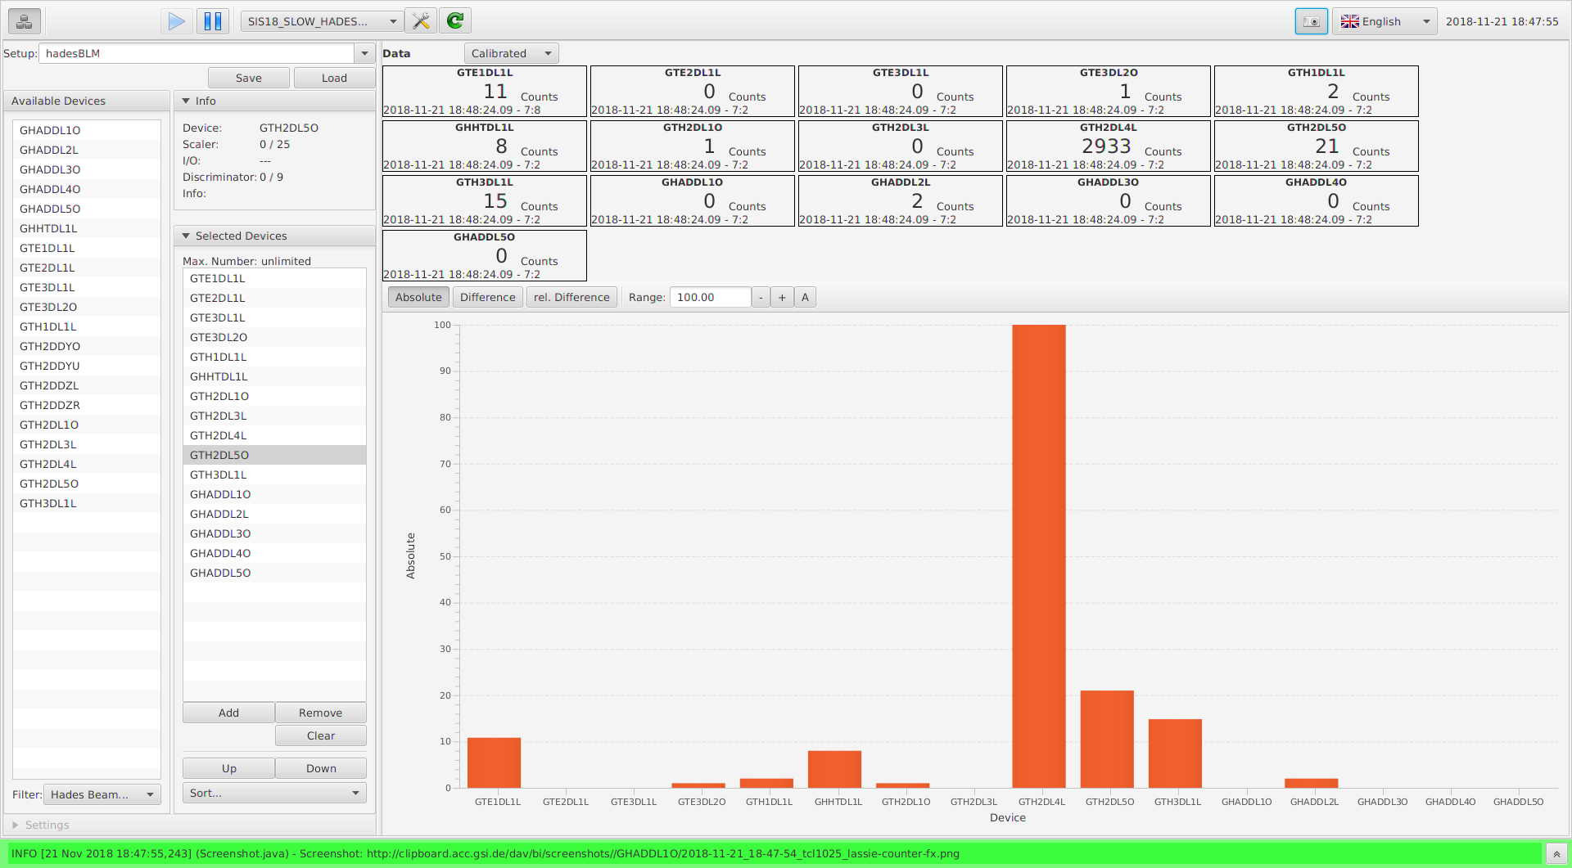
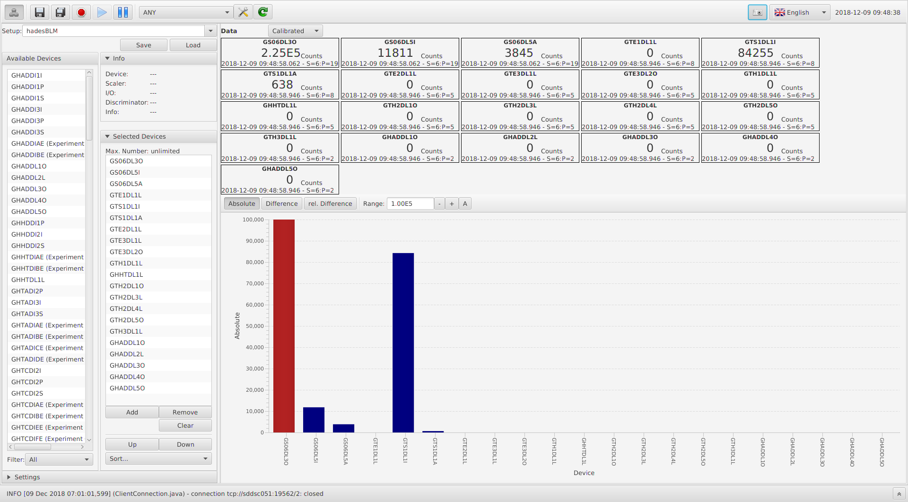
BLM DAQ and GUI

Slide 27
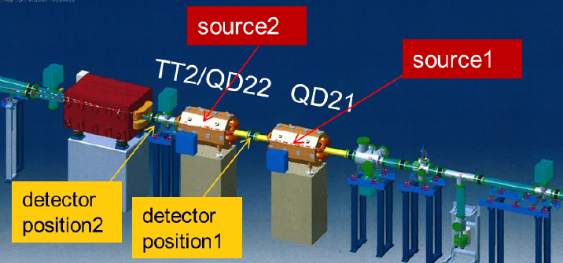
BLM Simulations
FLUKA study was performed in order to determine the optimum detector arraignment, size and position
typical simulation scenario: setup with two quadrupoles within NE-5 area
two loss location:
horizontal in the first focusing quadrupole
vertical loss in defocusing quadrupole
particle fluencies for protons, neutrons, electrons, gamma and heavy ions as a function of distance from the beam axis have been calculated

Slide 28
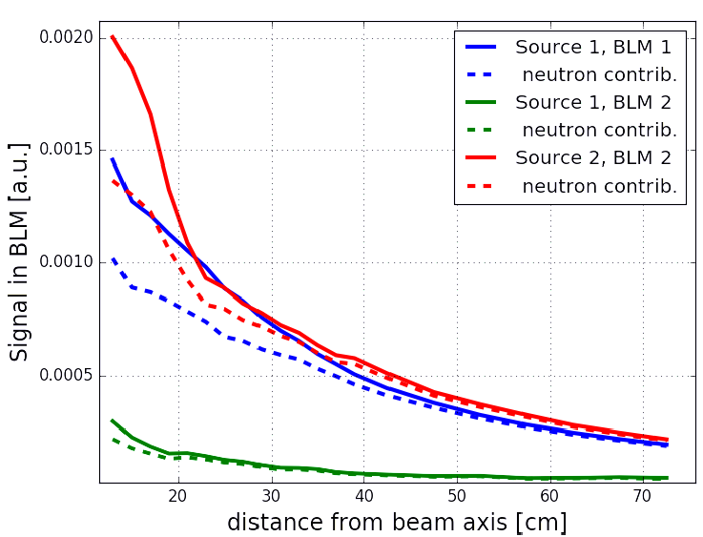
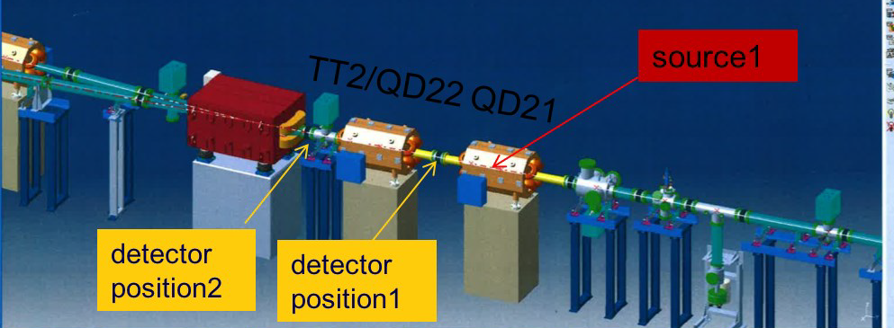
BLM Simulations
signal in the detectors is generated by fast neutrons through elastic scattering in detector material
contribution from protons is smaller and gradually decreases with distance
other particle types can be neglected
the estimated BLM signal as a function of distance from the beam axis for two BLM
positions and two loss scenarios. The signal from loss in the first quadrupole, seen by second detector, is significantly lower than the signal from loss in the second quadrupole

Slide 29
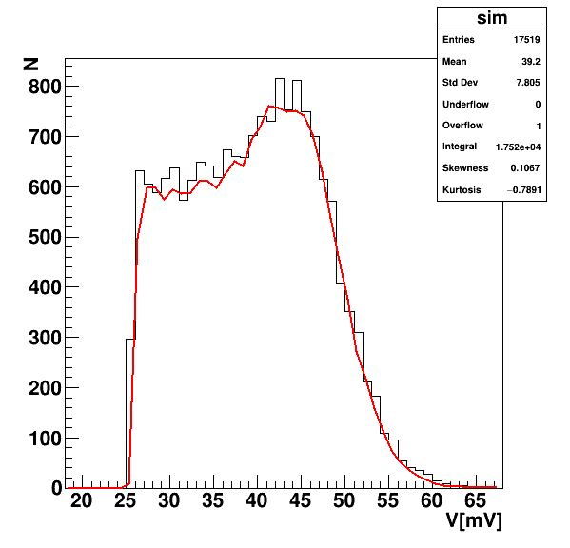
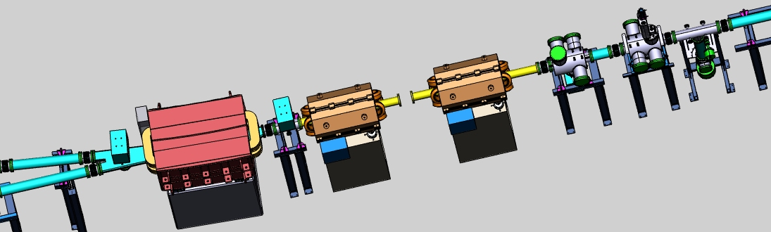
BLM Study
Study has been started in order to obtain quantitative description of beam loss
typical simulation scenario: setup with two quadrupoles within NE5 area
one loss location: SEM Foils
particle fluencies have been scored in tree positions
Cs-137
source
detector positions

Slide 30
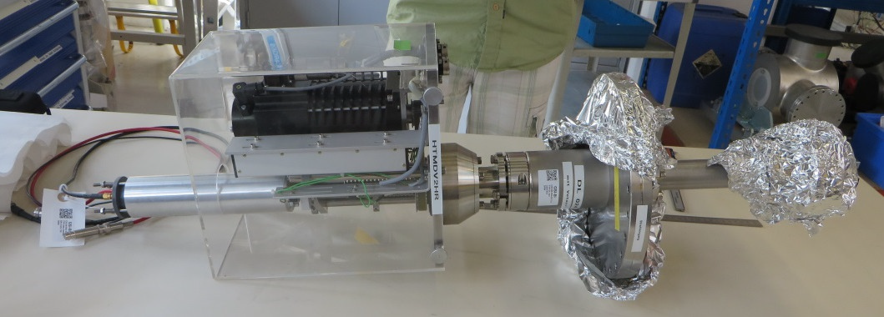
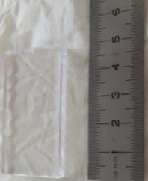
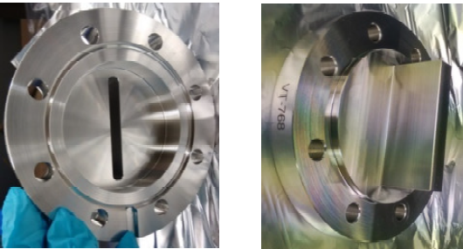
Halo Monitors
vertical and horizontal halo monitors
each of them is made of 2 scintillators which can be gradually moved into the beam using stepping motors
allow to monitor halo of slow extracted beams

Slide 31
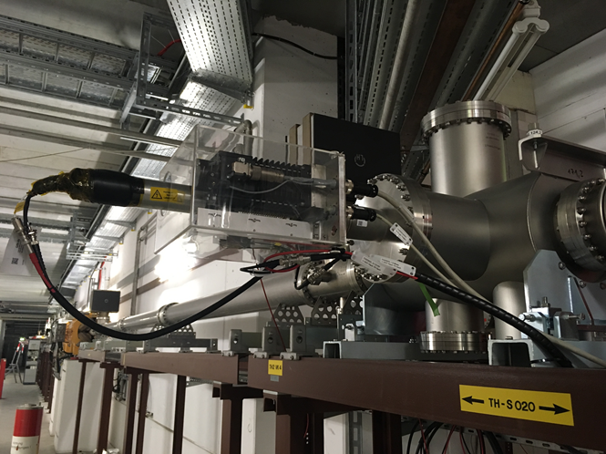
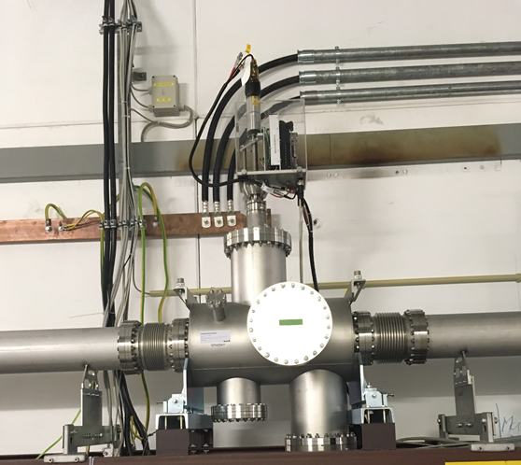
Halo Monitors
TH2DKZ Horizontal
TH2DKY Vertikal

Slide 32
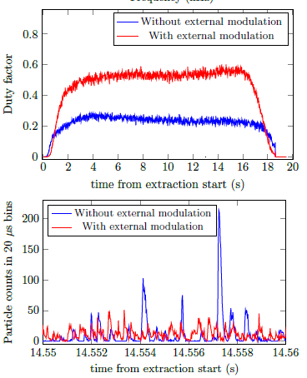
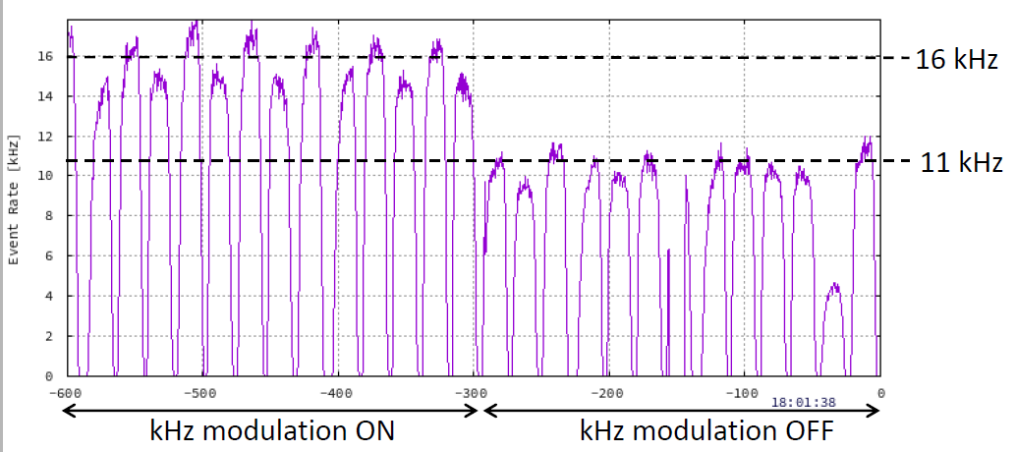
Singh Method
experimentally demonstrates that by introduction of further kHz-modulation on quadrupole currents with a specific amplitude and frequency, the inherent power supply fluctuations are mitigated leading to a smoothening of the beam temporal structure
Rahul`s talk in six weeks
“Transit time dependent tune modulation”
R. Singh et al. „Smoothing of the slowly extracted coasting beam from a synchrotron“
submitted on 19th of April 2019 https://arxiv.org/abs/1904.09195

Slide 33
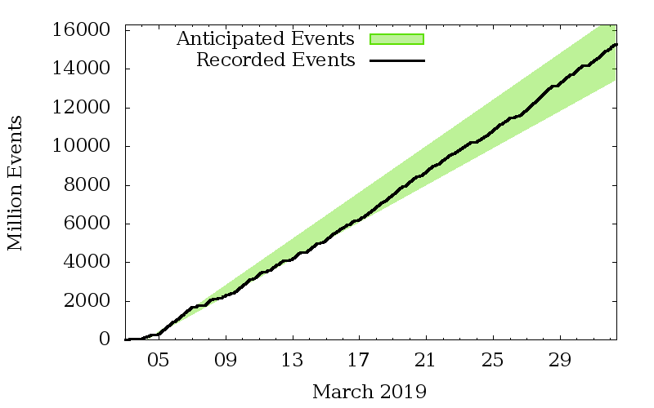
Summary
https://web-docs.gsi.de/~webhades/onlineMon/mar19/hades-online.html

Slide 34
Thank You! M. Sapinski, P. Boutachkov, H. Bräuning, S. Damjanovic, C. Dorn, H. Graf, T. Hoffman, C. Andre, R. Singh, P. Forck, RoFi, H. Reeg, A. Petit, C. Schmidt, H. Rödl, K. Steiner, M. Schwickert, S. Sorge, P. Schütt, S. Reimann, E. Nickchen, G. Zeitträger our HADES collegues and many, many others ...

