Slide 1
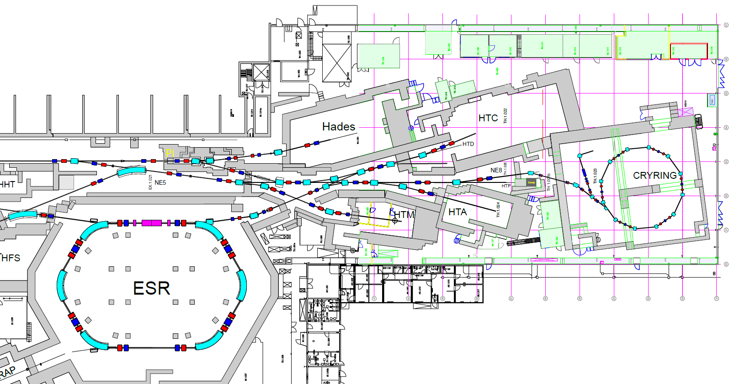
mCBM + R3B UPGRADE
GHTCDF1
GHTDDF1
HTD Dump
Elektronik-Rack Oben
(Treppen, neben Atomphysikmesshütte)
GHTCDF3

