Slide 1
Plan 02_03_06_00_01 Teil 1

Slide 2
Plan 02_03_06_00_01 Teil 2

Slide 3
Plan 02_03_06_00_02 Teil 1

Slide 4
Plan 02_03_06_00_02 Teil 2

Slide 5
Plan 02_03_06_00_02 Teil 3

Slide 6
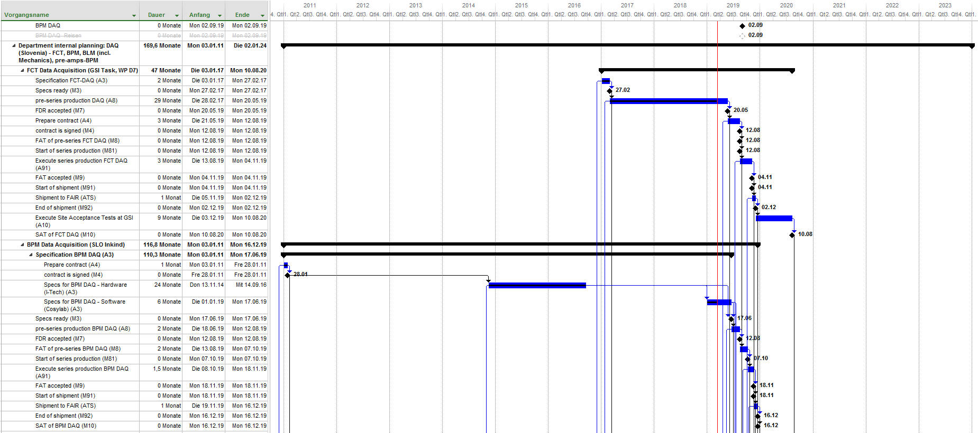
Plan 02_03_06_00_03 Teil 1

Slide 7
Plan 02_03_06_00_03 Teil 2

Slide 8
Plan 02_03_06_00_04 Teil 1

Slide 9
Plan 02_03_06_00_04 Teil 2

Slide 10
Plan 02_03_06_00_05

Slide 11
Plan 02_03_06_00_06 Teil 1

Slide 12
Plan 02_03_06_00_06 Teil 2

Slide 13
Plan 02_03_06_00_06 Teil 3

Slide 14
Plan 02_03_06_00_07

Slide 15
Plan 02_03_06_00_08 Teil 1

Slide 16
Plan 02_03_06_00_08 Teil 2

Slide 17
Plan 02_03_06_00_09

Slide 18
Plan 02_03_06_00_10

Slide 19
Plan 02_03_06_00_11

Slide 20
Plan 02_03_06_00_12

Slide 21
Plan 02_03_06_00_13

Slide 22
Plan 02_03_06_00_14

